Slide 1
GIMS: Mandatory information for COPRAR EDI

Slide 2
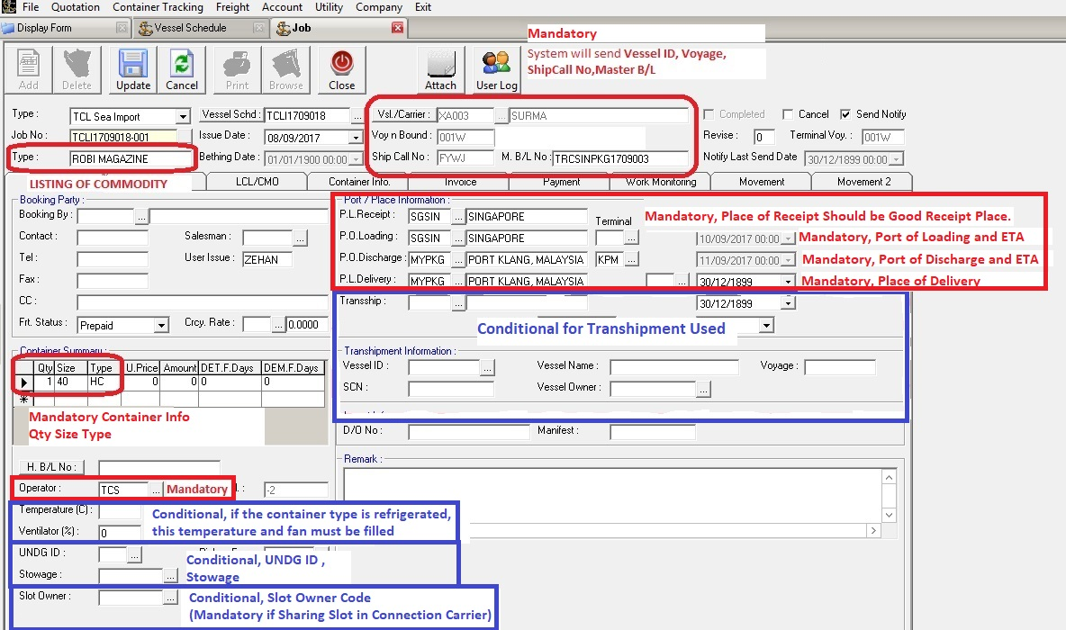
For Job 1 screen.

Slide 3
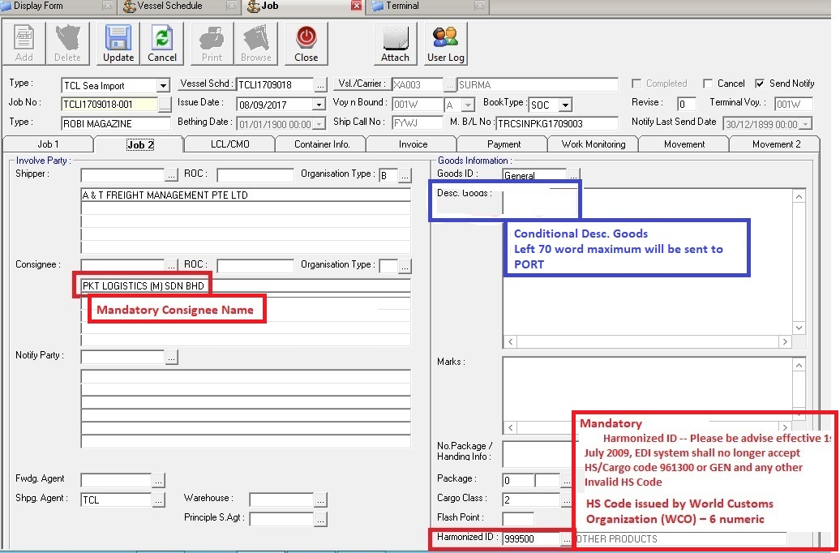
For Job 2 screen.

Slide 4
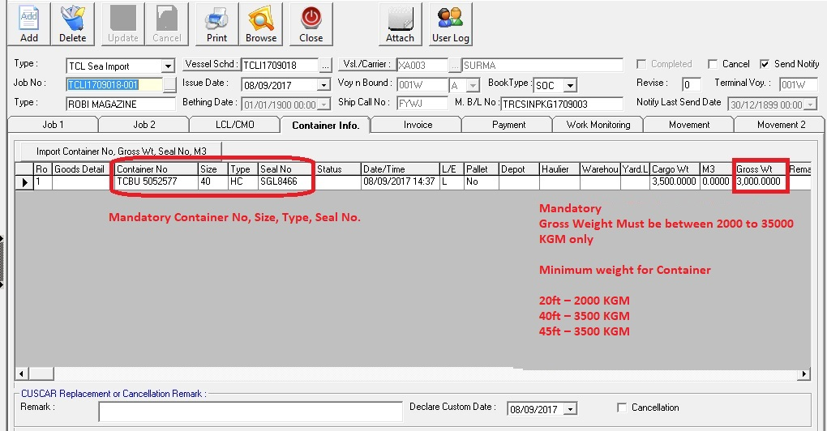
For Container Info screen.

Slide 5
Generate COPRAR EDI File
Follow the screen to generate COPRAR EDI file and sending email to port.

Slide 6
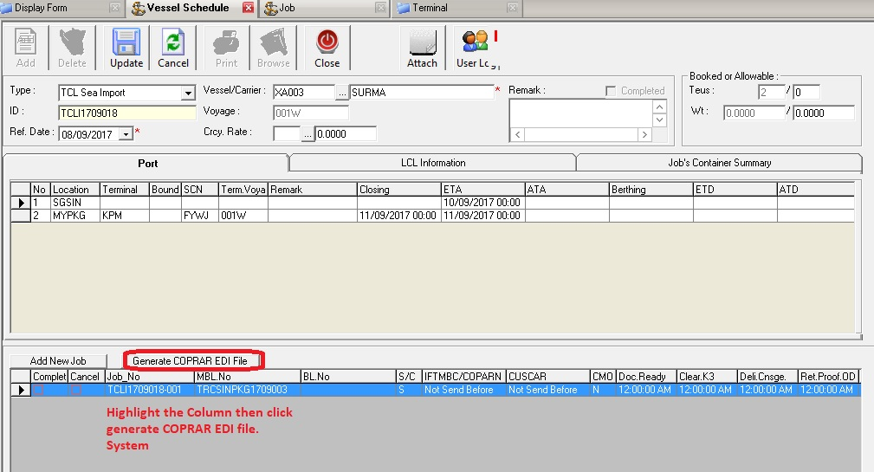
For vessel schedule screen

Slide 7
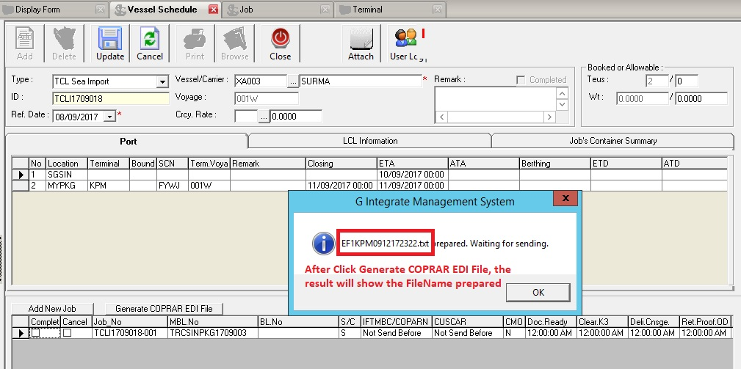
Vessel Schedule Generate EDI File

Slide 8
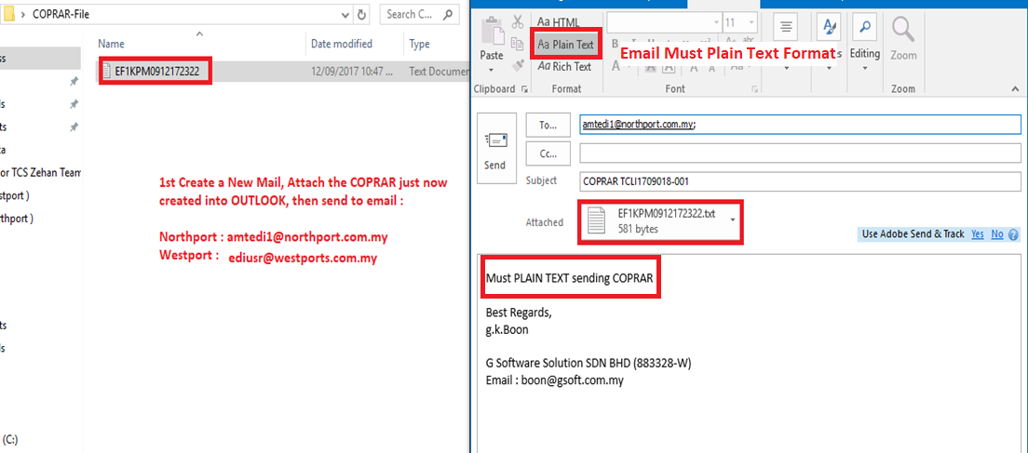
Outlook to send email
Attach the filename generate COPRAR EDI file in Outlook

Slide 9
Acknowledgement File
After sending email to port .
port system will return one acknowledgement file back .
pls open the attachment to check is success or fail .

Slide 10
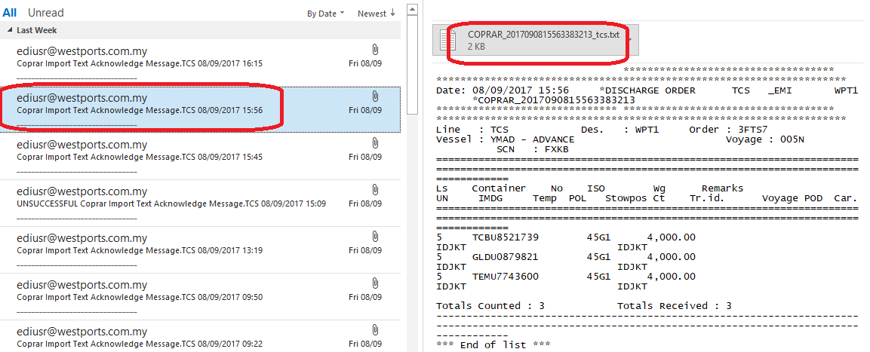
Acknowledge file received by Outlook
Success or Fail also will received Acknowledge file from Port System.

